Slide 1
CSS Text Styling
Originally: R. Connolly,
Modified: 2020 Y. Amannejad & 2023 PJ Perri & 2026 Jim Davis

Slide 2

Objectives
By the end of this part of the course, you will
learn properties for font
Learn how to use open access fonts
learn properties for paragraphs
Randy C, Yasaman

Slide 3
CSS Text Styling
CSS provides two types of properties that affect text.
Font properties that affect the font and its appearance.
Paragraph properties that affect the text in a similar way no matter which font is being used
Most common font properties include
Font font-size
font-family font-variant
font-style font-weight

Slide 4
Font Family
A few issues here
A word processor on a desktop machine can make use of any font that is installed on the computer; browsers are no different.
However,
just because a given font is available on the web developer’s computer does not mean it will be available for all users.
For this reason, include code to provide a web font stack
a series of alternate fonts to use in case the original font choice is not on the user’s computer

Slide 5
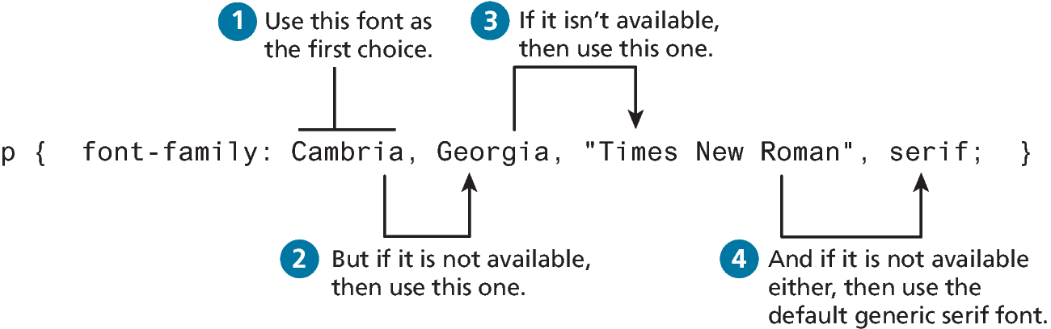
Font Family

Slide 6
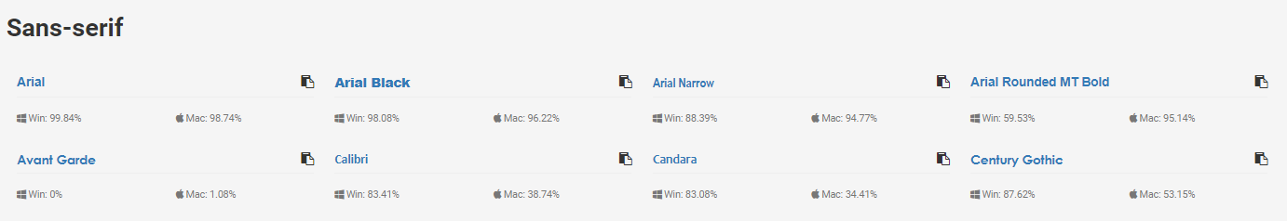

Web Safe Font Prevalence
https://www.cssfontstack.com/

Slide 7
Different font families

Slide 8
When to use Serif & Sans-serif Fonts
Serif
Sans-serif
Considered to be:
the most readable for large blocks of text
Traditional & thus authoritative
Use when your audience is expecting to spend time with ‘quality’ materials.
It possibly facilitates faster reading.
Considered to be:
Cleaner, thus more modern
Most legible when the font is very small or on low-quality monitors
Use in captions, footnotes and other short & small bocks of text and when the audience is expecting ‘currency’.

Slide 9
When to use Cursive & Fancy fonts? …never. Possibly for a H1 Page title When to use Monospaced fonts? …code

Slide 10
@font-face
The future is now
Over the past few years, the most recent browser versions have begun to support the @font-face selector in CSS.
This selector allows you to use a font on your site even if it is not installed on the end user’s computer.
Due to the on-going popularity of open source font sites such as Google Web Fonts (http://www.google.com/webfonts) and Font Squirrel (http://www.fontsquirrel.com/), @font-face seems to have gained a critical mass of widespread usage.

Slide 11
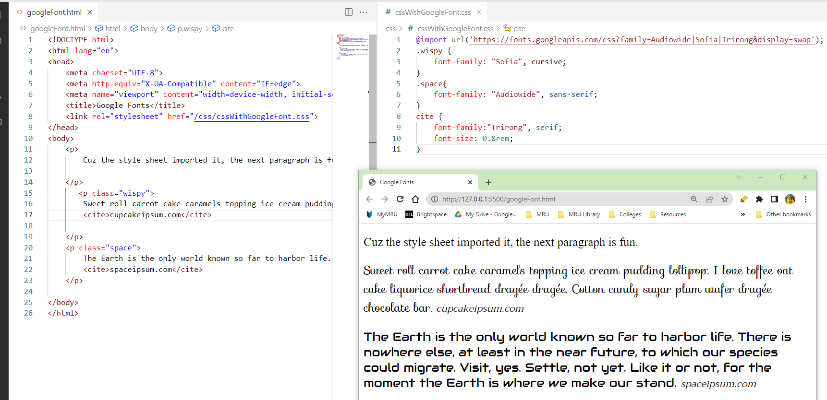
Google Font
https://fonts.google.com/
Include the Google Fonts into your external .css by importing it in the first line.

Slide 12
Using em & %
Things can quickly become difficult to calculate actual sizes when there are nested elements

Slide 13
The rem unit
So? Use rem (for root em unit). This unit is always relative to the size of the root element (i.e., the <html> element).

Slide 14
Font Sizes: The Defaults
If we wish to create web layouts that work well on different devices, we should learn to use relative units such as em units or percentages for our font sizes
Note the default sizes:

Slide 15
Font Weight: JBYCDMYS
Google Fonts made web fonts available to the masses, before that font-weight was typically set to either normal or bold
For instance, the popular Open Sans font has five different weights: light, regular, semi-bold, bold, and extra bold
Within your CSS you specify which of these weights by using their numeric value, which typically ranges from 100 and 900, with larger numbers bolder than lower numbers

Slide 16
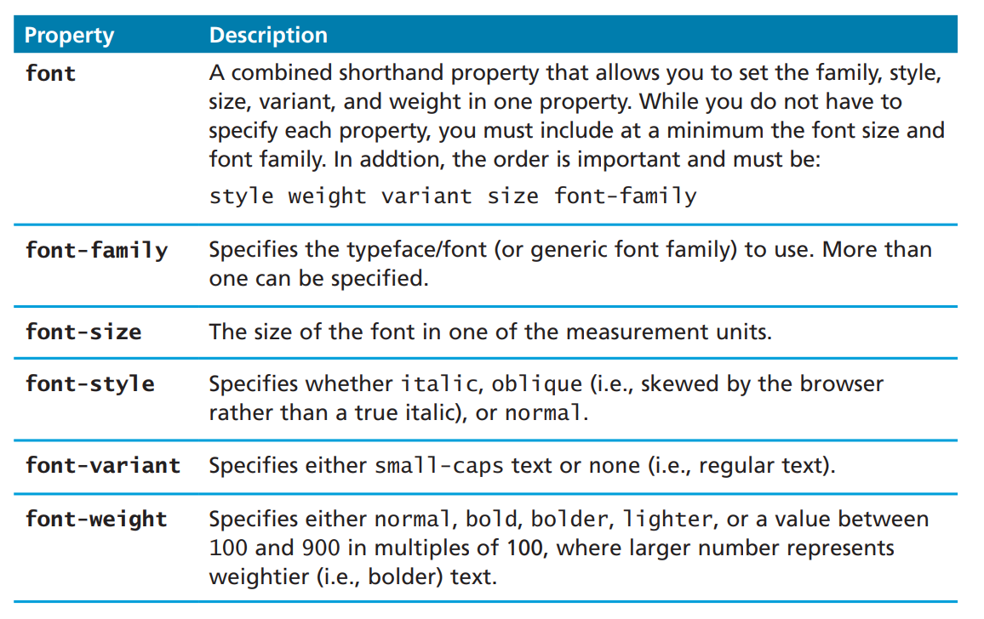
Font Properties
Similarly,
Font-style, font, variants are only useful if they help communicate meaning.
Small-caps? Really?
All caps? Are you kidding me?

Slide 17
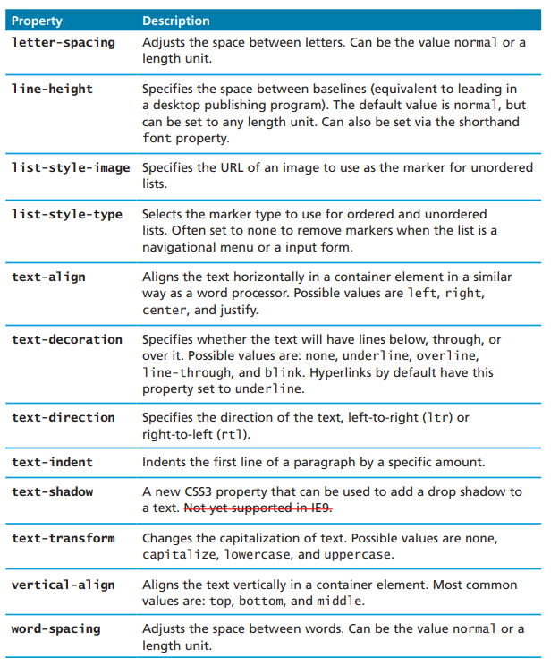
Paragraph Properties
Just as there are properties that affect the font in CSS, there is also a range of CSS properties that affect text independently of the font.
The table describes the following paragraph properties in detail.
My suggestions of useful properties:
Text-indent helps when the user reads large blocks of text.
Text-align
Left align is most readable
Center only for titles
Right align to link a figure’s caption if it is placed on the figure’s left side.
NEVER use justify
Letter- and word-spacing used for small fonts only.
Line-height to increase the space between lines is only occasionally useful.

Slide 18
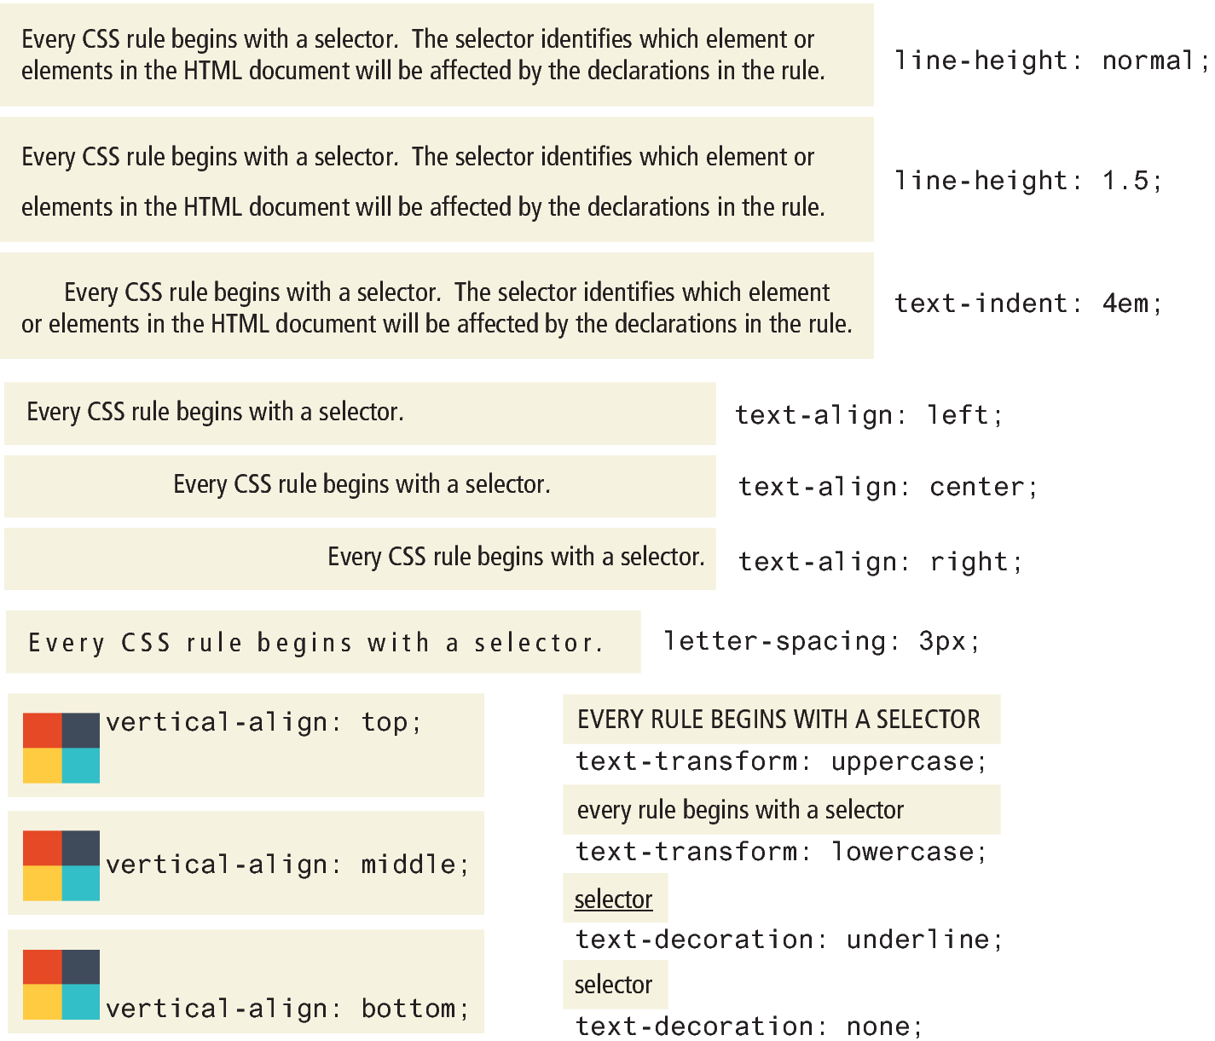
Sample text properties

Slide 19
Any Question?

